Slide 1
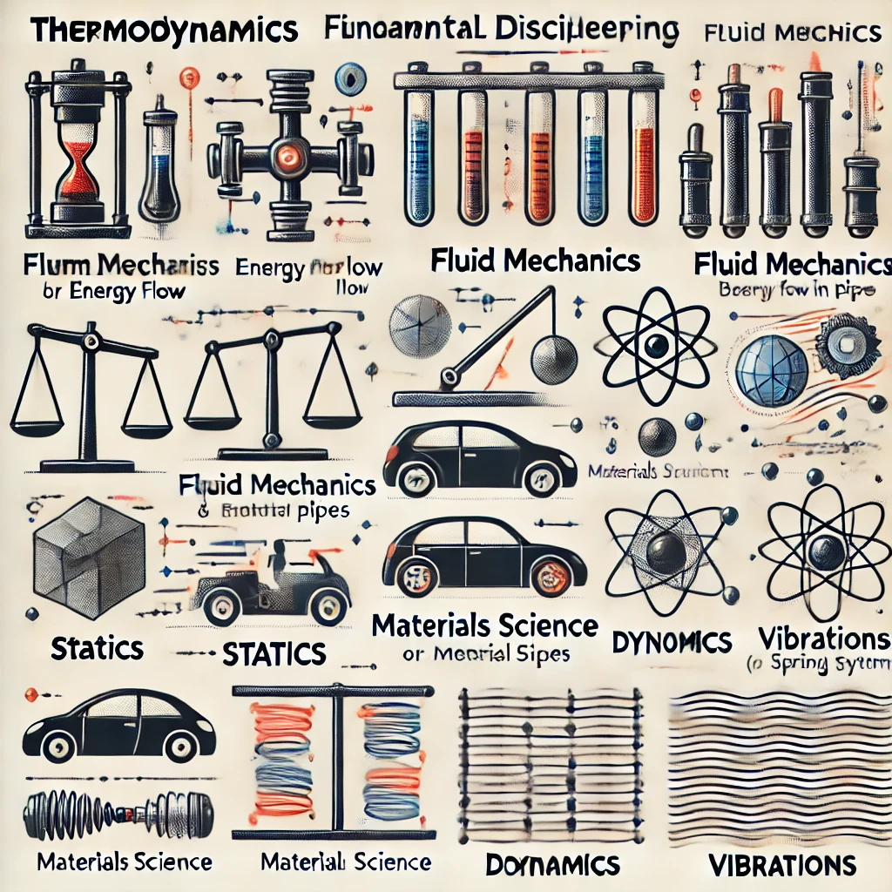

標題叫啥??
教授: 詹魁元
學生: 吳家安、李京睿、王邑安

Slide 2
Introduction
Methods
Results
Discussion

Slide 3
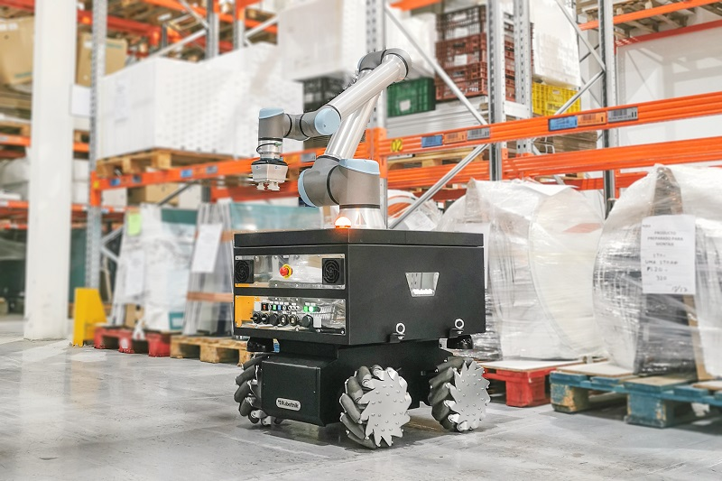
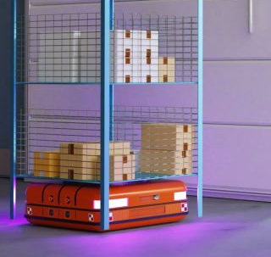
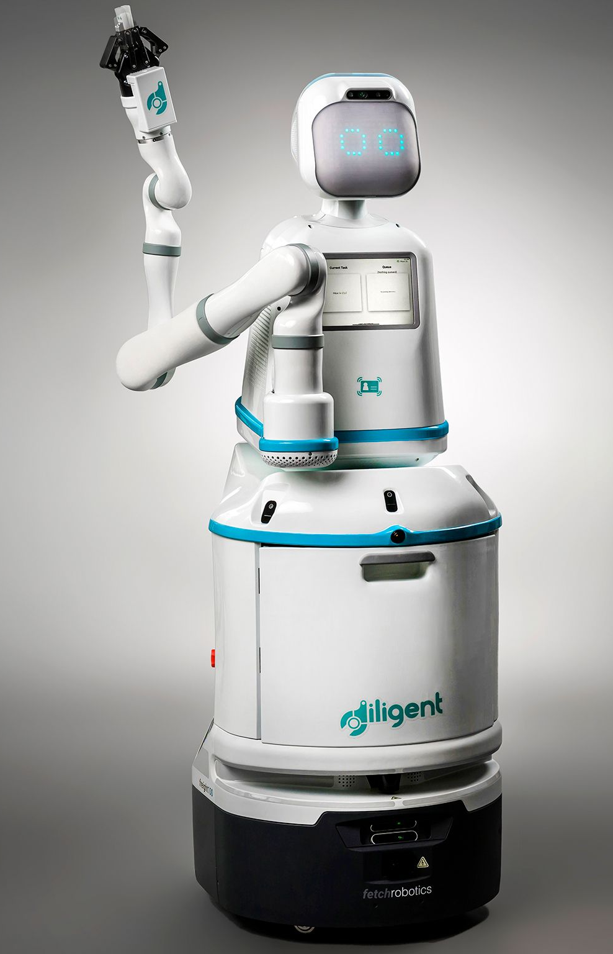


Autonomous Mobile Robots (AMR)
Motion Planning
Introduction
Methods
Results
Discussion

Slide 4
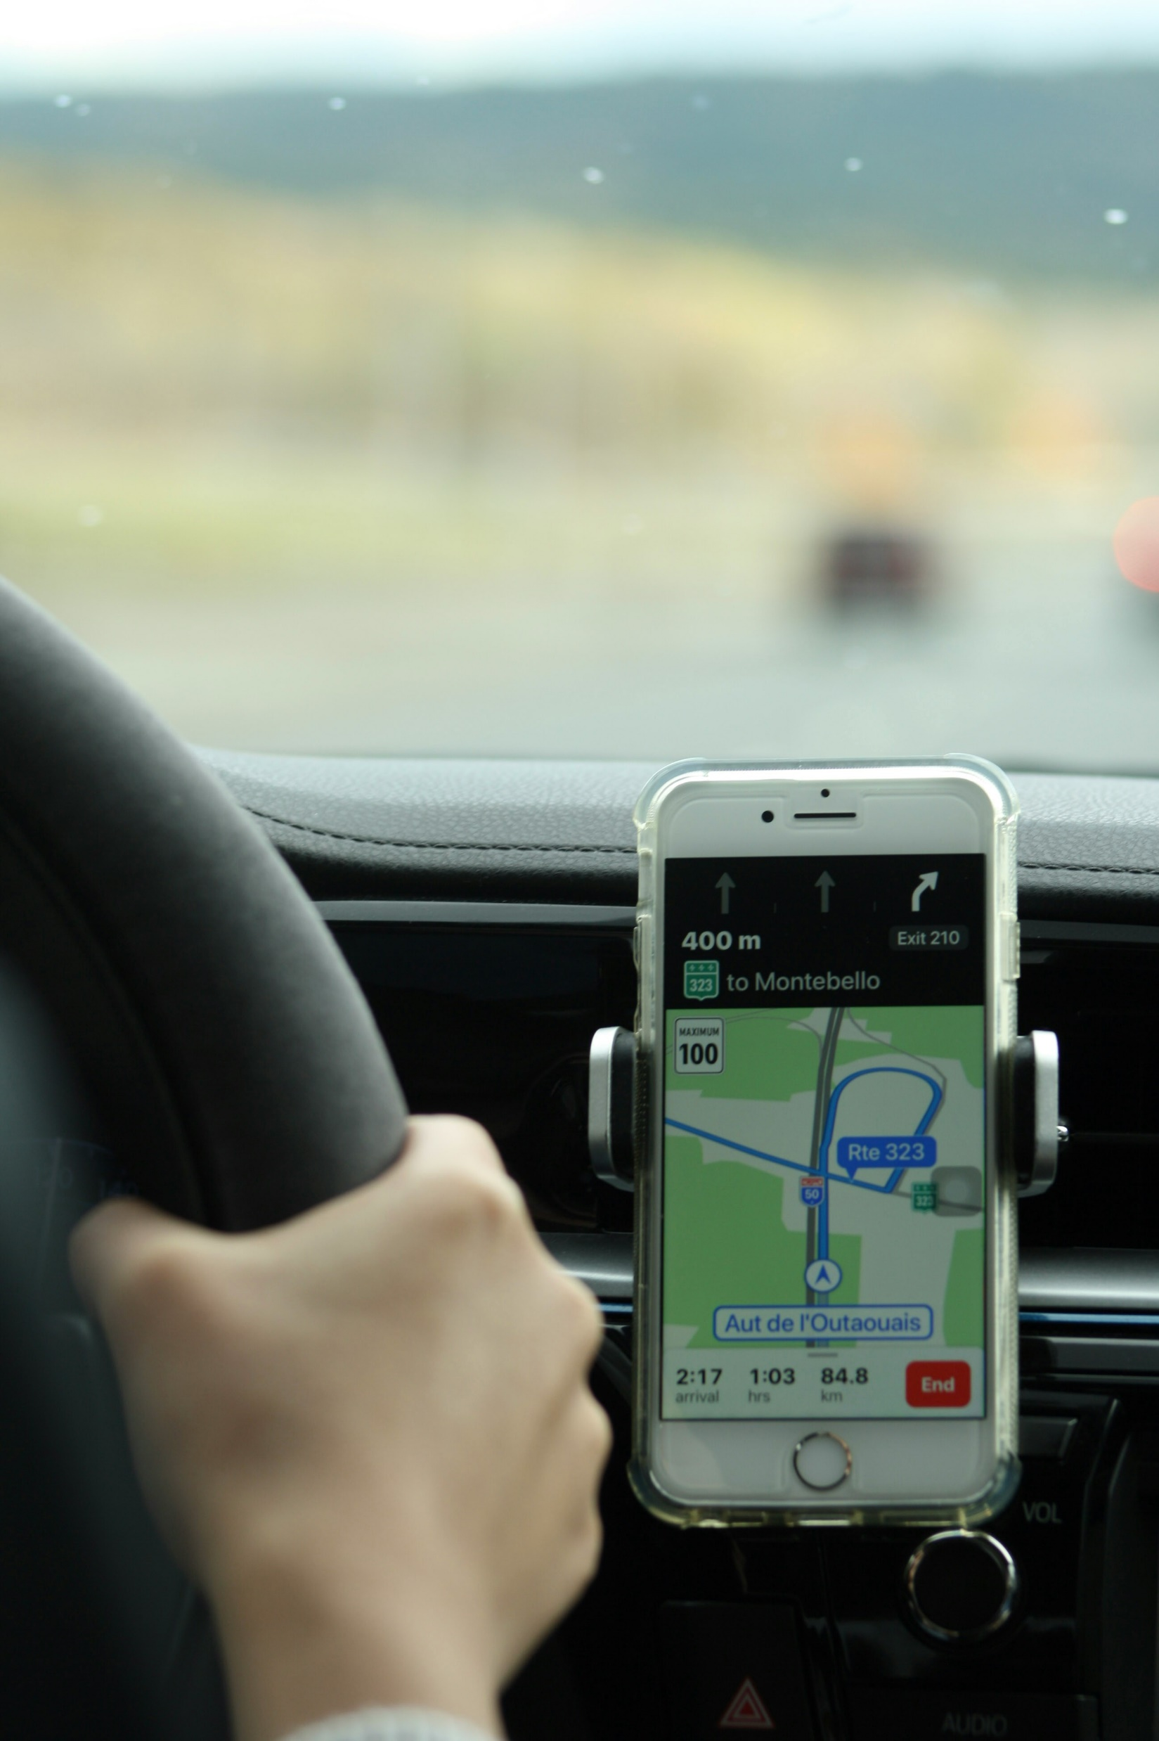
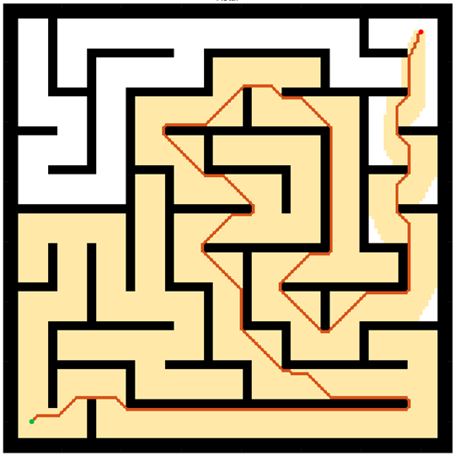
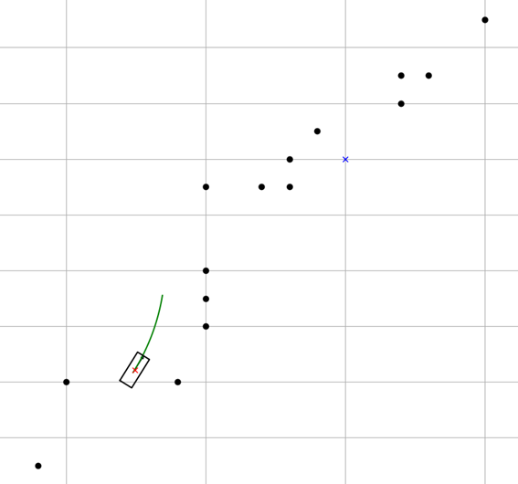
Motion Planning
Motion Planning finds a continuous sequence of valid configurations that safely and efficiently guide a robot from start to goal.
Global Planning
Navigation
Avoiding Static obstacle
Local Planning
Handle emergency
Evading moving objects
Google Map
Global Planning
Driver
Local Planning
Introduction
Methods
Results
Discussion

Slide 5
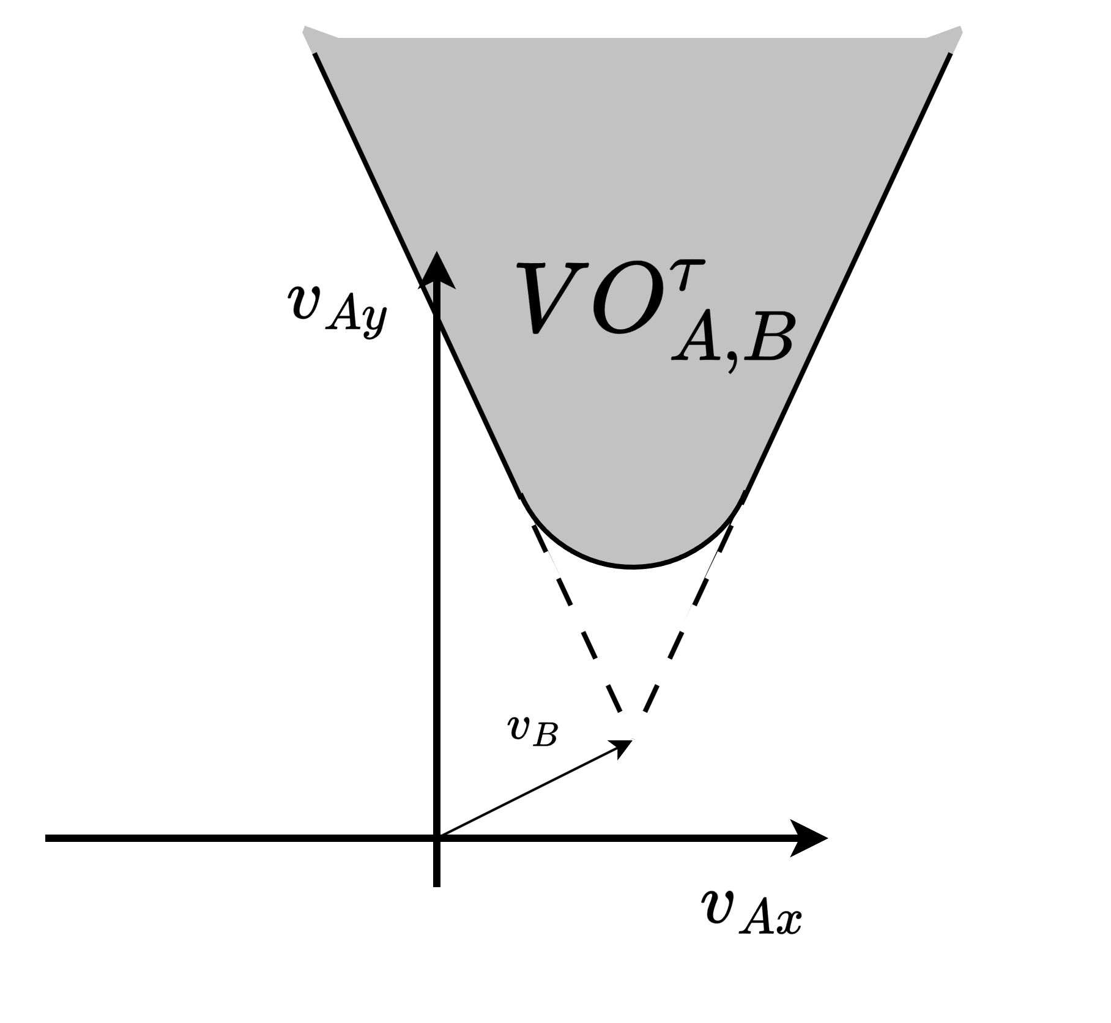
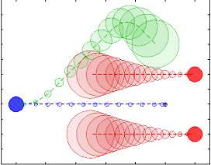
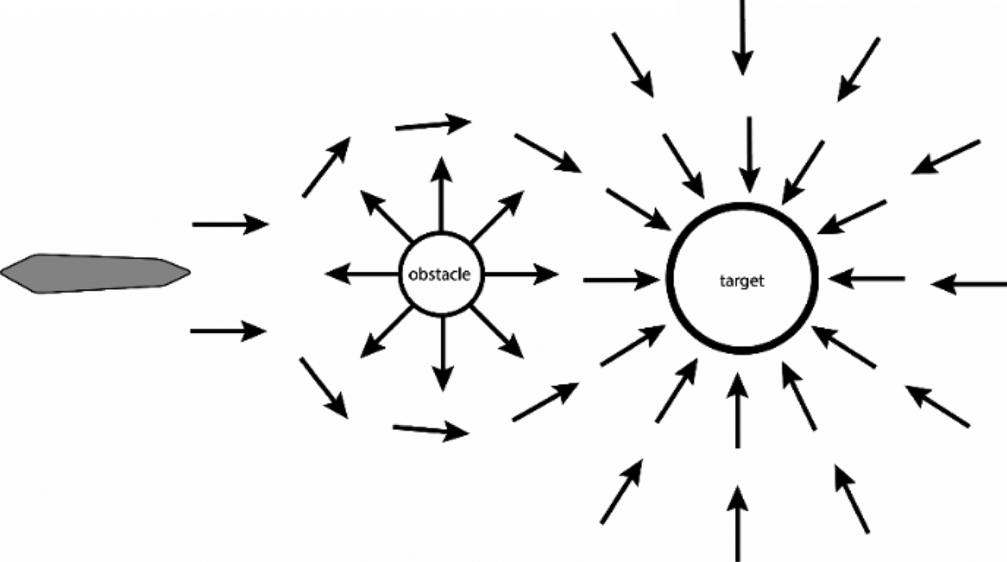
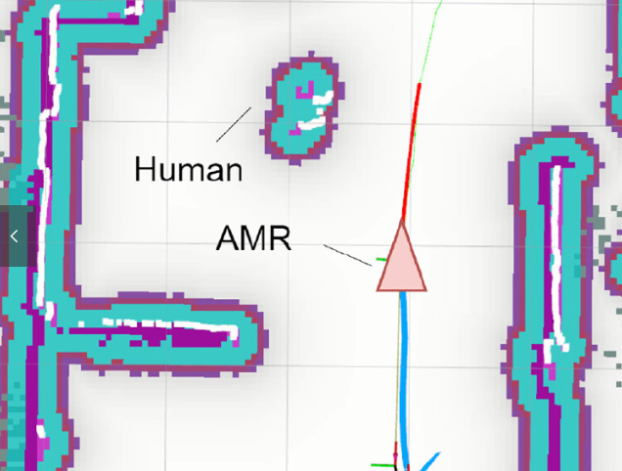
Local Planning
[1] Polvara, Riccardo, et al. "Obstacle avoidance approaches for autonomous navigation of unmanned surface vehicles." The Journal of Navigation 71.1 (2018): 241-256.
[3] Du Toit, N. E. and J. W. Burdick (2010). Robotic motion planning in dynamic, cluttered, uncertain environments. 2010 IEEE International Conference on Robotics and Automation, IEEE.
[2] Wu, C.-H. and K.-Y. Chan (2024). "Developing a dynamic obstacle avoidance system for autonomous mobile robots using Bayesian optimization and object tracking: Implementation and testing." Proceedings of the Institution of Mechanical Engineers, Part C: Journal of Mechanical Engineering Science 238(9): 4007-4022.
Artificial Potential Fields (APF) | Dynamic Window Approach (DWA) | Velocity Obstacles (VO) | Model Predictive Control (MPC)
Simple for real-time avoidance | Effective, Dynamic feasible | Deal with multi-agents systems | Handles robot dynamics
Local minima issue | Struggle with moving obstacles | Poor to handle unknow intension | Computationally expensive
[1]
[3]
[2]
former lab members’ research
My research want to use
Introduction
Methods
Results
Discussion

Slide 6
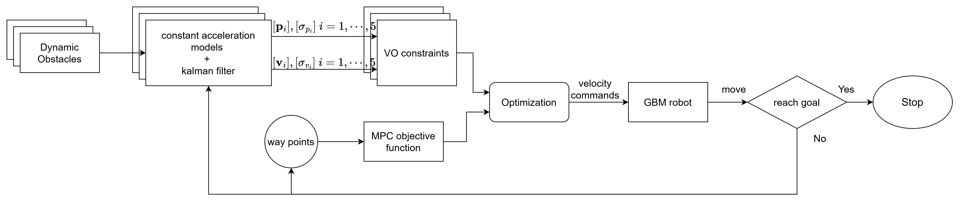
Structure
Prediction step
Optimization step
Introduction
Methods
Results
Discussion

Slide 7
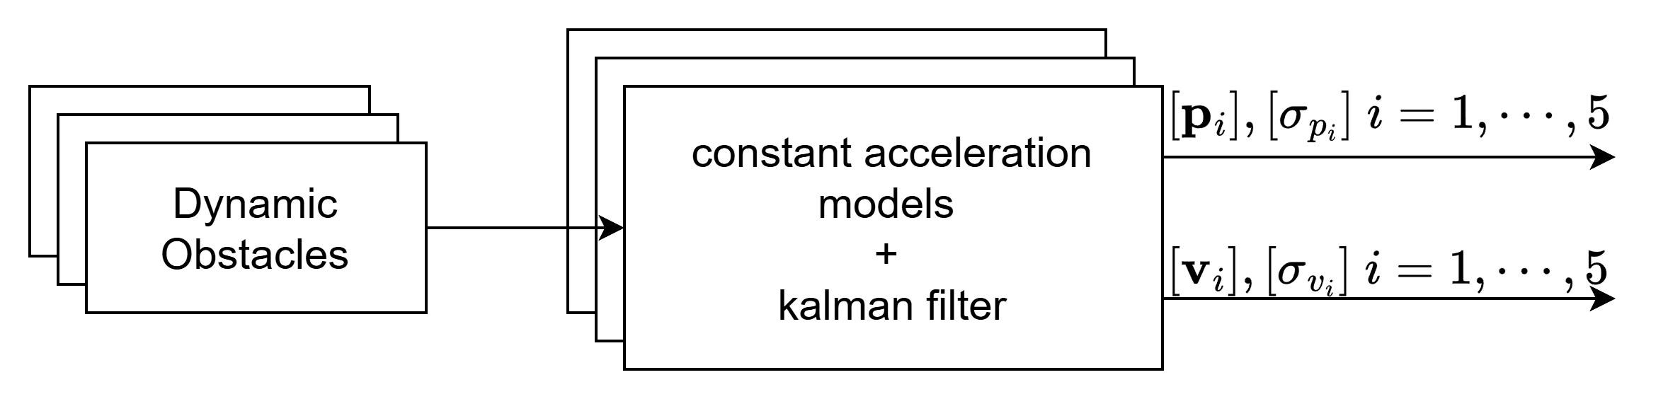

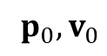
Prediction step
Prediction step
$$p_{i},v_{i}, i=1,2,3…$$
$$p_{0},v_{0}$$
Dynamic Obstacle
Introduction
Methods
Results
Discussion

Slide 8
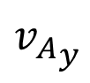
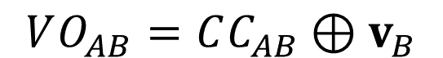
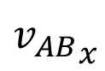
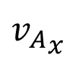
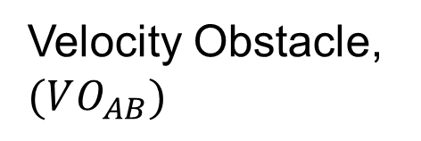
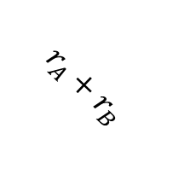
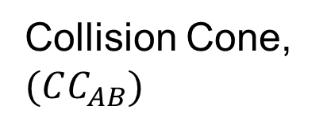
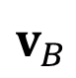
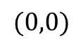
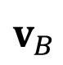
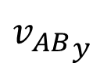
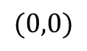
Optimization step -- VO
$$VO_{AB}=CC_{AB}⊕v_{B}$$
C-space
Velocity space
$${v_{AB}}_{y}$$
$${v_{A}}_{y}$$
Collision Cone, $(CC_{AB})$
Velocity Obstacle, $(VO_{AB})$
$$v_{B}$$
$$r_{A}+r_{B}$$
agent B
$${v_{AB}}_{x}$$
$${v_{A}}_{x}$$
$$(0,0)$$
$$(0,0)$$
$$v_{B}$$
agent A
Introduction
Methods
Results
Discussion

Slide 9
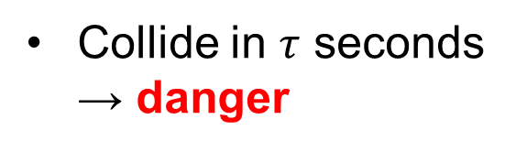
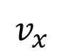
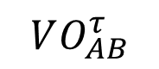
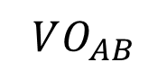
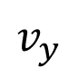
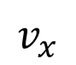
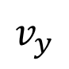
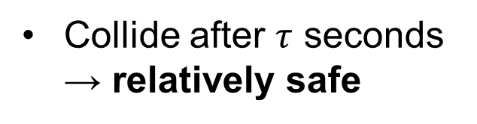
Optimization step -- VO
$$v_{y}$$
$$v_{y}$$
Collide in $τ$ seconds → danger
$$VO_{AB}$$
$$VO_{AB}^{τ}$$
Collide after $τ$ seconds → relatively safe
Cut off the relatively safe region
feasible velocity region
$$v_{x}$$
$$v_{x}$$
Introduction
Methods
Results
Discussion

Slide 10
What is machine??
Introduction
Methods
Results
Discussion

Slide 11
What is machine??
Introduction
Methods
Results
Discussion

Slide 12
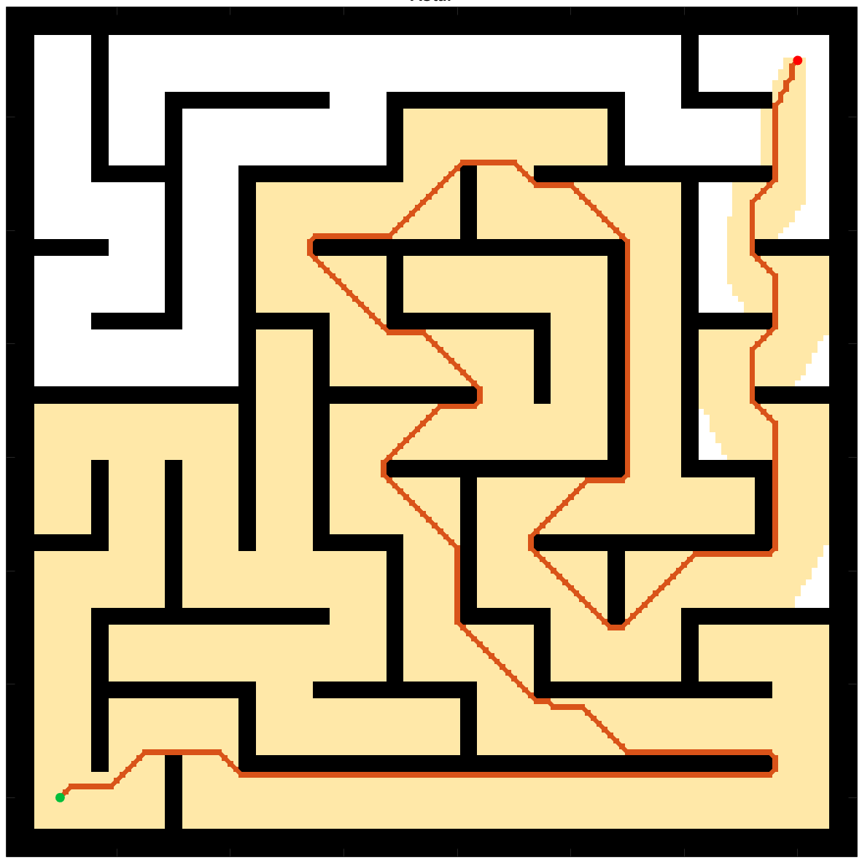
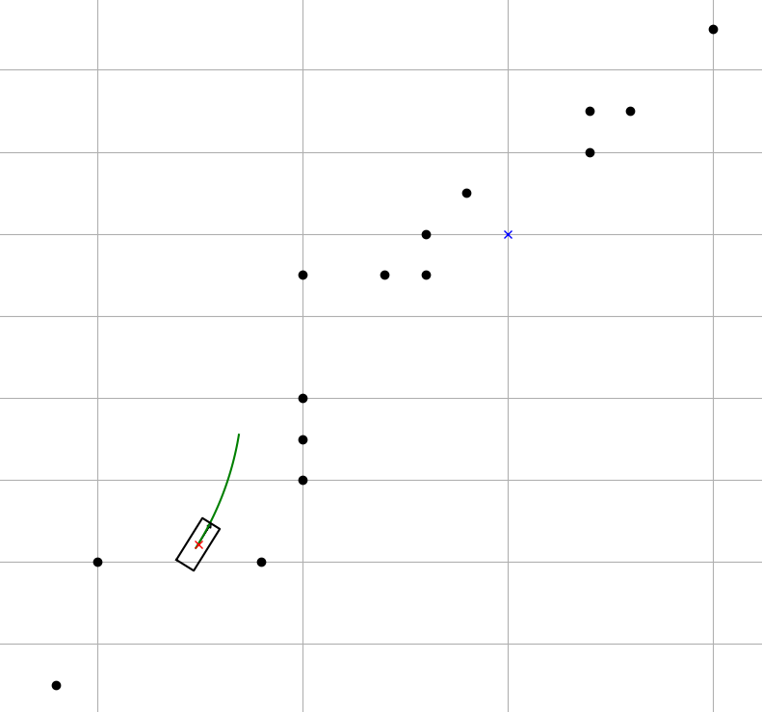
Introduction of Path Planning
B
A
Global Planning
Local Planning
Introduction
Methods
Results
Discussion

